Slide 1


SBD.GLOBAL.VTEX-SalesOrderCreate flow
sbd-SBD.Global.VTEX-SalesOrderFeed-Outbound-useast-dev-la
Async VTEX APIM call
Triggered on a Timer based recurrence
sbd-common-xmltransformation-ia2-useast-dev-la
sbd-common-JDE-callOrchestrator-ISE-useast-dev-la
sbd-common-CopyOriginalBlob
sbd-common-xmltransformation-ia2-useast-dev-la
Sales Order Create Process API
Singleton SAP SHP Order
Slide 2
Transform message to ERP input format
Create Aggregate message
Transform message to VTEX input format
Send to back VTEX
sbd-SBD.Global.VTEX-SalesOrderCreate-OnRamp-useast-dev-la
sbd-common-CopyOriginalBlob
Singleton JDE Order
sbd-common-xmltransformation-ia2-useast-dev-la
sbd-common-sapshp-callBAPI-ISE-useast-dev-la
Create Aggregate message
sbd-common-xmltransformation-ia2-useast-dev-la
Note: Below maps will be combined to create Sales Order Create API Request / Responses
Map-1: Map-SBD.Global.JDE-SalesOrderCreate_Request
Map-2: Map-SBD.Global.JDE-SalesOrderCreate_Response
Map-3: Map-SBD.Global.JDE-SalesOrderCreate_ErrorResponse
Map-4: Map-SBD.Global.SHP-SalesOrderCreate_Request
Map-5: Map-SBD.Global.SHP-SalesOrderCreate_Response
Async VTEX APIM call

Slide 2
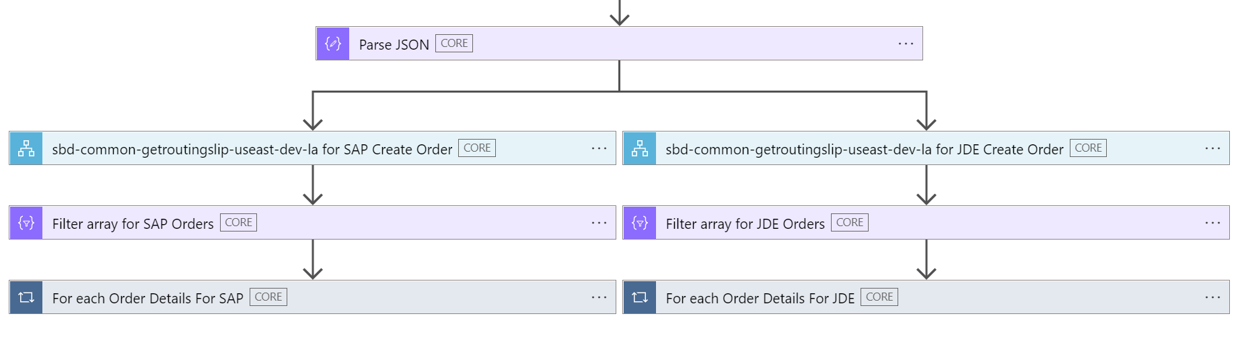
sbd-SBD.Global.VTEX-SalesOrderCreate-OnRamp-useast-dev-la
Timed reccurence trigger
Call logic app sbd-SBD.Global.VTEX-SalesOrderFeed-Outbound-useast-dev-la to get sales orders from VTEX feed
Get routing slip for SAP and JDE an dispatch accordingly
Use On-Ramp logic app to both extract mixed SAP and JDE orders form sales order feed instance separate and filter orders to respective workflow sequences.
Create blob of order create Singleton message and store in blob container for JDE.
Send trigger message to service bus queue for JDE Receive Logic app to initiate workflow sequence.
Create blob of order create Singleton message and store in blob container for SAP.
Send trigger message to service bus queue for SAP Receive Logic app to initiate workflow sequence.

Slide 3


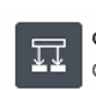

JDE flow
Slide 3
Request
API Management Gateway
Response Success ?
Response Failure ?
Inline Compose Sales Order Notification Request Success
Inline Compose Sales Order Notification Request for failure
VTEX Service
Request
VTEX Service
Request
APIM Gateway
APIM Gateway

Slide 4

SAP Flow
Slide 4
Request
SAP BAPI Call
Response Success ?
Response Failure ?
Inline Compose Sales Order Notification Request for Success
Inline Compose Sales Order Notification Request for failure
VTEX Service
Request
VTEX Service
Request
APIM Gateway
APIM Gateway

